Slide 1
Apache Spark
Pravin Y Pawar

Slide 2

Spark Overview
Cluster computing platform
Designed to be fast and general purpose
Speed
Is important in processing large datasets as it creates difference when data is being explored
Extends MapReduce model to efficiently support more types of computations
Runs computations in memory
Generality
Covers a wide variety of workloads which earlier required different distributed systems
Including
Batch applications
Iterative algorithms
Interactive queries
Streaming
Easy and inexpensive to combine different processing types in data pipelines

Slide 3



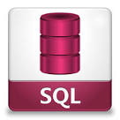



Spark Overview (2)
Spark handles highly accessible, simple APIs in
Java
Python
Scala
SQL
Integrates easily with other big data tools like
Hadoop (HDFS) and other ecosystem tools
Kafka
AWS

Slide 4
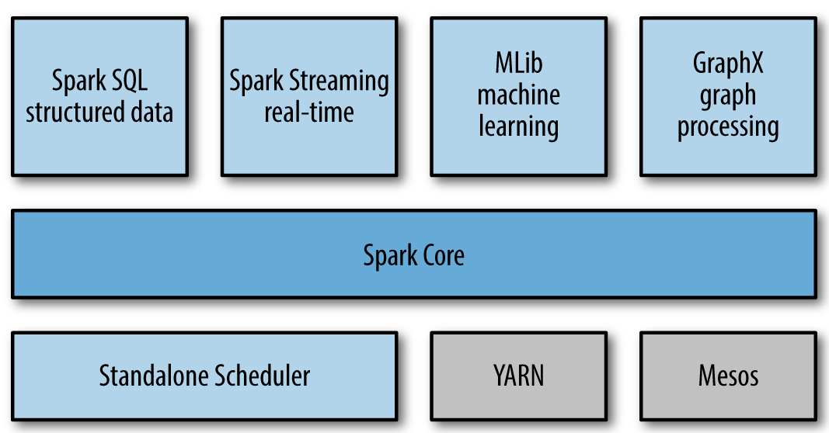
Unified Stack
Ref : https://www.oreilly.com/library/view/learning-spark/9781449359034/ch01.html

Slide 5

Spark Core
Contains the basic functionality of Spark, including components for
task scheduling
memory management
fault recovery
interacting with storage systems etc.
Home to the API that defines resilient distributed datasets (RDDs), which are Spark’s main programming abstraction
Provides many APIs for building and manipulating these collections

Slide 6

Spark SQL
Spark’s package for working with structured data
Allows querying data via SQL as well as the Apache Hive variant of SQL
called the Hive Query Language (HQL)
Allows developers to intermix SQL queries with the programmatic data manipulations
supported by RDDs in
Python
Java
Scala
all within a single application
Tight integration with the rich computing environment provided by Spark makes Spark SQL unlike any other open source data warehouse tool

Slide 7
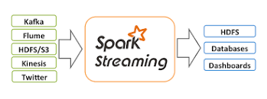
Spark Streaming
Spark component that enables processing of live streams of data
Examples of data streams include web servers log files
Provides an API for manipulating data streams that closely matches the Spark Core’s RDD API
Designed to provide the same degree of fault tolerance, throughput, and scalability as Spark Core

Slide 8

MLlib
Built in library containing common machine learning (ML) functionality
Provides multiple types of machine learning algorithms, including
Classification
Regression
Clustering
Collaborative filtering
Supporting functionality such as data import and model evaluation
Provides some lower-level ML primitives, including a generic gradient descent optimization algorithm
All of these methods are designed to scale out across a cluster

Slide 9

GraphX
Library for
manipulating graphs (e.g. a social network’s relations graph)
performing graph-parallel computations
Extends the Spark RDD API, allowing us to create a directed graph with arbitrary properties attached to each vertex and edge
Provides
various operators for manipulating graphs (e.g., subgraph and mapVertices)
library of common graph algorithms (e.g., PageRank and triangle counting)

Slide 10



Cluster Managers
Spark is designed to efficiently scale up from one to many thousands of compute nodes
Can run over a variety of cluster managers, including
Hadoop YARN
Apache Mesos
Simple cluster manager included in Spark itself called the Standalone Scheduler
Kubernetis
If you are just installing Spark on an empty set of machines
the Standalone Scheduler provides an easy way to get started
If you already have a Hadoop YARN or Mesos cluster,
Spark’s support for these cluster managers allows your applications to also run on them

Slide 11
Thank You!
Reference :
Learning Spark By Karau, Konwinski
In our next session: Spark – Getting Started

